Slide 1
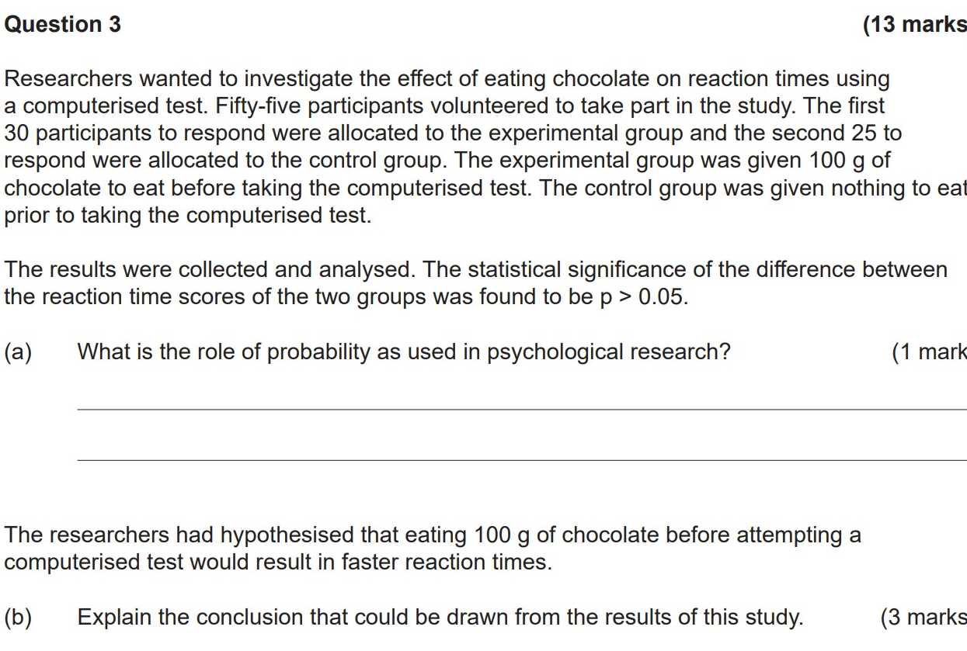

Do now
Reminders:
Phones away
Bags on floor
Books out
Pens out
Whiteboard

Slide 2
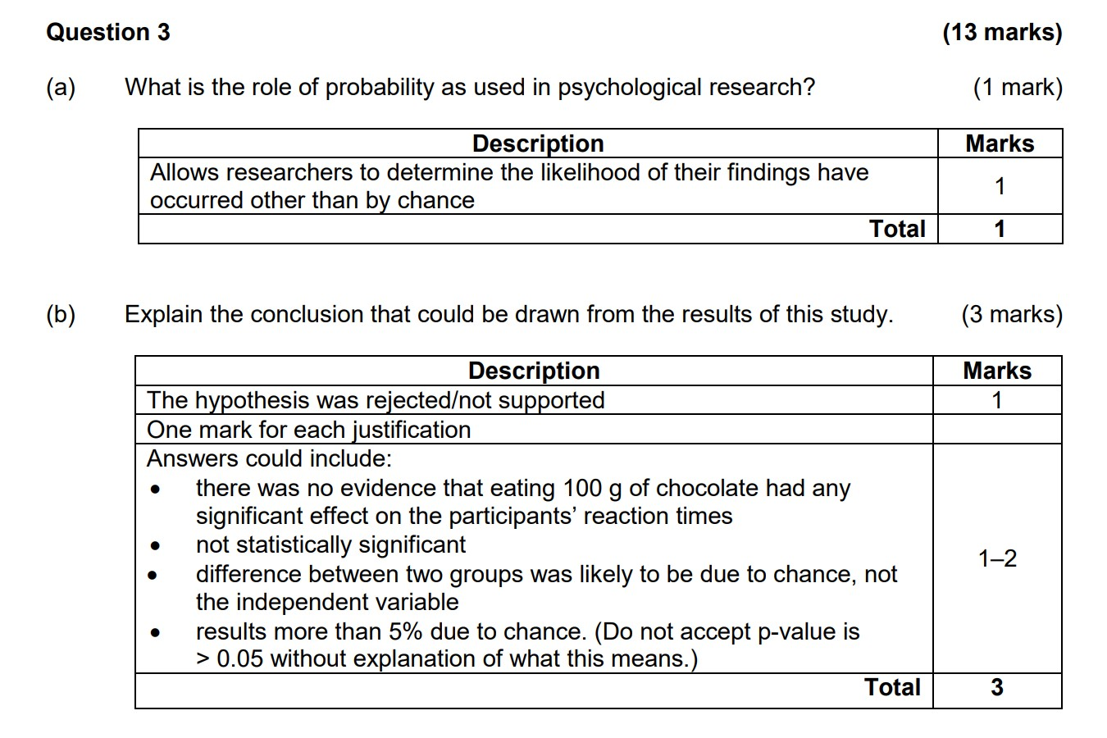
Answer

Slide 3


Slide 4
answer
The result is statistically significant as more than 95% of the results are due to the change in the independent variable
There is only 5% chance that the results are due to chance
This is a real difference caused by the independent variable

Slide 5


Success Criteria
Learning Intention
Research methods syllabus
Planning and conducting psychological research
• research terminology
• ethics in psychology research
• steps in the scientific method
• differences between sample and population data
• experimental research methods
• non-experimental (descriptive) research methods
Processing and evaluating psychological research
• methods of displaying quantitative data—tables, graphs and diagrams
• interpretation of the following forms of data:
• role of probability
• use of correlation to establish association between variables
• sources of error in data and ways of reducing them
o evidence-based conclusions related to the hypothesis
By the end of the lesson, I will be able to:
Describe the use of non-experimental research including: case studies, correlations and archival research.
Evaluate case studies and correlational studies.
Describe characteristics of experimental reseach
I will have answered all ‘check for understanding’ questions regarding correlations and case studies.
I will have researched real-life correlation studies in twin and adoption studies to assess the strength and direction of associations.
I will have researched real-life case studies on feral children to assess the uses, strengths and limitations of case-studies.
I will have researched Archival research and answered comprehension questions.
I will work on my group project.

Slide 6
Non-experimental research
Non-experimental research is research that lacks the manipulation of an independent variable. Instead, they measure variables as they naturally occur (in the lab or real world). This is useful when:
Concept development
Why do researchers use non-experimental research:
Ethics
It is not ethical, feasible or possible to manipulate an independent variable (e.g., does damage to a person’s hippocampus impair the formation of long-term memory traces?).
Exploratory
The research question is broad and exploratory (e.g., what is it like to be a working mother diagnosed with depression?)
Statistics
The research question pertains to a non-causal statistical relationship between variables (e.g., is there a correlation between verbal intelligence and mathematical intelligence?). Or it relates to a single variable (e.g., How accurate are people’s first impressions?).

Slide 7

Non-experimental research is used:
- when manipulation of the IV is impossible OR
- when a researcher has not got a specific research question yet – exploring a topic before setting up a experimental research. There are two types:
1. Case study
2. Correlation
3. Archival research
Concept Development
A detailed study of a specific subject, such as a person, group, place, event, organization, or phenomenon.
Uses multiple forms of data collection methods to collect rich data on one topic.
May study several variables.
e.g. Phineas Gage or looking at a small group of patients after similar brain injuries
Looks at the strength and relationship between two variables.
Does not prove causation.
The variables studied are called behavioral variables rather than IV and DV.
Archival research, researchers access repositories of old material to analyse.
Checking for understanding
Why would a researcher use non-experimental research? What are the key characteristics of a case study?

Slide 8
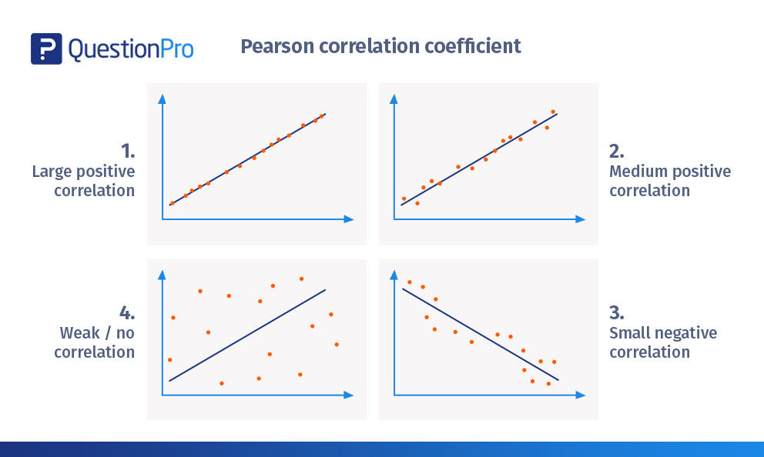


Correlation Studies
Correlational studies are a non-experimental method to identify the strength and direction of a relationship between two variables.
Concept Development
Positive Correlation: Two variables change in the same direction - one increases, the other increases. One decreases, the other decreases. For example, increased caffeine intake and energy levels.
Negative Correlation: Two variables change in the opposite direction - one increases, one decreases. For example, the less hours you sleep, the more tired you become.
Correlation coefficient: A numerical value (r) that indicates both the strength and direction of a relationship between two values. This ranges from -1 to +1. See the images below.
Checking for understanding
What would be the correlation coefficient for the above scatterplots? Provide an example for each of the above scatterplots.

Slide 9
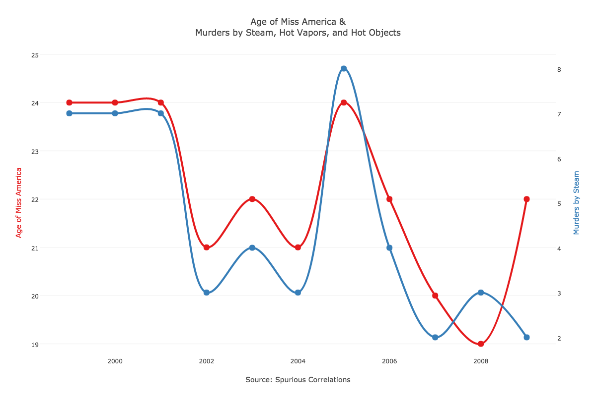
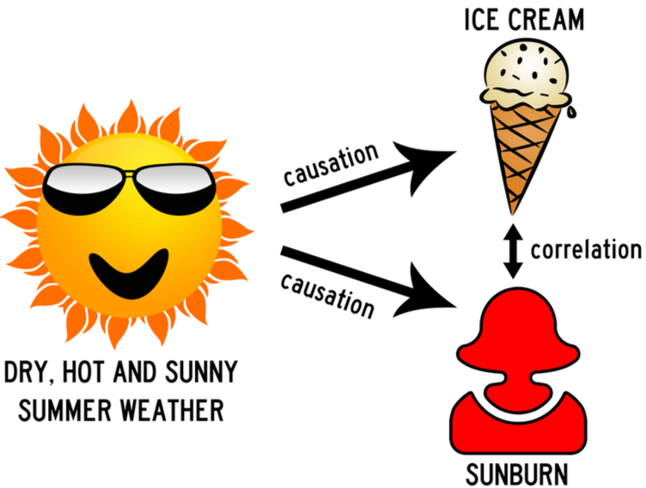
Correlation Studies
Strengths of Correlation Studies
Correlation allows the researcher to investigate naturally occurring variables that maybe unethical or impractical to test experimentally
Correlation also helps researchers identify related variables to direct a future hypothesis and study it experimentally.
Limitations of Correlation Studies
Correlation does not equal causation - there are many spurious relationships that exist in the world! There is no independent variable, as no variable was manipulated, BOTH were measured.
It could be that the cause of both changes in the two variables are caused by a third (extraneous) variable – example: growing up in a violent home - and that both the watching of T.V. and the violent behaviour are the outcome of this.
Variables in correlation studies are known as ‘behavioural variables’ instead of IV and DV.
Concept Development
Checking for understanding
If two monozygotic twins (100% same genes) have a high IQ, showing a strong positive correlation between gene similarity and IQ score. What could be a third, extraneous factor?

Slide 10
Authentic problem-solving
Activity
15 minutes
In groups of 3-4
Look up studies that have used r-value correlations to identify relationships between variables (e.g. IQ between twins, self-regulation among adoptive parents and children).
Find out:
Identify two variables that are moderately positively correlated.
Identify two variables that are negatively correlated (can be small/low).
Identify two variables that have little to no correlation.
Explain how these relationships could be caused by something else.
Be prepared to share!

Slide 11

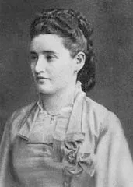
Case studies
A case study is the intensive, thorough examination of a single subject, or very few subjects, with a unique characteristic.
Concept Development
In case studies, the data collection methods made are generally wide‐ranging and detailed. This usually includes interviews, observations, surveys, brain scans and more.
These are generally used as exploratory research or due to an inability to manipulate variables (e.g. ethics).
Some famous case studies in psychology include Phineas Gage, H.M, Anna O, Kitty Genovese and Little Albert.
More on case studies: https://wikieducator.org/Introduction_to_Research_Methods_In_Psychology/Non-Experimental_Research_Methods/Case_Studies
Checking for understanding
Why do psychologists use case studies?

Slide 12

Authentic problem-solving
Activity
15 minutes
https://www.planetcustodian.com/shocking-cases-of-feral-children/12449/#Marina_Chapman_-_Columbia
https://allthatsinteresting.com/genie-wiley-feral-child
In groups of 3-4
Look up case studies of feral children (Genie Wiley’s case is particularly useful).
Find out:
How are case studies useful in examining human development?
What are the strengths and limitations of using case studies in psychology?
Use examples from your research into feral children.
Be prepared to share!

Slide 13
Archival research
Archival research, researchers access repositories of old material to analyse.
Concept Development
Archival research is commonly used in Psychology is the form of a ‘meta-analysis’.
Examine the following links (and your own research) to complete the following questions:
Describe in your own words what Archival research is.
Explain the strengths and weaknesses of Archival research in Psychology.
Provide 2 examples of meta-analysis in Psychology, explaining why they are examples of archival research.
https://www2.archivists.org/book/export/html/14460
https://wikieducator.org/Introduction_to_Research_Methods_In_Psychology/Non-Experimental_Research_Methods/Archival_Research

Slide 14
Experimental research
Definition: A type of research that research utilizing randomized assignment of participants to conditions and systematic manipulation of variables with the objective of drawing causal
Concept Development
Main Characteristics:
Has an independent and dependent variable
Attempts to control as many extraneous variables as possible
Tries to determine cause and effect relationships (IV impacts DV)
Other characteristics:
Uses a form of participant allocation (experimental design)
Experimental and control group
Use of operationalized hypothesis
Use of statistical significance testing (with p values) to draw conclusions
Checking for understanding
Why do psychologists use experimental research?

Slide 15
Experimental research - types
Definition: A type of research that research utilizing randomized assignment of participants to conditions and systematic manipulation of variables with the objective of drawing causal
Concept Development
Laboratory Experiment:
Experiment happening in a controlled environment
e.g. Milgram, Asch
Field Experiment:
Sometimes researchers might opt to conduct their experiments “in the field”
e.g. experimenter might have a person pretend to faint and observe to see how long it takes onlookers to respond.
Great way to see behaviour in realistic settings
Quasi-experiment:
often referred to as natural experiments because the researchers do not have true control over the independent variable.
e.g. Age, gender, race, sex
Checking for understanding
Describe each of the types of experiments Evaluate the use of each type of experiment in terms of reliability and validity

Slide 16
TASK 3: Independent revision
Open up the syllabus on SEQTA
Choose an item in yellow from your revision list
Work silently and independently
Elaboratively rehearse material and try a memory technique!

